Slide 1

PGR – Beyond Sensitivity and Specificity
Brian Locke
Notes:
Primer on probability https://twitter.com/tivadardanka/status/1580159358469427200?s=43&t=G_9TuqEhsJ2WVeEfQHWWVQ
https://hbiostat.org/blog/post/backwards-probs/
[ ] make a tweet tutorial on this
Refs:
https://hbiostat.org/blog/post/class-damage/
[ ] this one is key and links to a lecture on the same.
Harrell’s take on this: http://hbiostat.org/bbr/dx.html
Classification link https://hbiostat.org/blog/post/classification/
Better metrics: https://hbiostat.org/blog/post/addvalue/
https://doi.org/10.1002/1097-0258(20000715)19:13%3C1783::AID-SIM497%3E3.0.CO;2-B
Lastly – good background on theory of statistics with many good links http://hbiostat.org/bayes/bet/highview.html

Slide 2
A 55F who is a nurse comes in with sepsis and chest pain, a RUL infiltrate that is cavitating in XR.
Blood cultures are received in the ER. She receives Vanc, Cefepime, and Azithromycin.
Blood and sputum cultures are collected. MRSA nasal swab is obtained and negative. Influenza A is positive.
She says she’s been sick for a week, thought she was doing better then worsened.
Pulmonary is consulted to help 12h after admission. CT is recommended confirms what looks to be a necrotizing pneumonia, no evidence of a lesion. Some ipsilateral LAD. No underlying lung disease.
Do you advise the team to stop vancomycin?

Slide 3
CME:
Question: your intern says that “MRSA nasal swab is a good test at ruling out MRSA pneumonia.” You are feeling extra pedantic today, insisting only on the most truthful statements. Which of the following is true?
MRSA nasal swab is a good test at ruling out disease because it has a high specificity
MRSA nasal swab is a good test at ruling out disease because it has a high sensitivity
MRSA nasal swab is not a good test, but can still be useful.
Ugh. Sensitivity and specificity? These metrics are confusing.
Notes:
it can be useful because MRSA pneumonia is uncommon but not uncommon enough to ignore.

Slide 4
Answer
Question: your intern says that “MRSA nasal swab is a good test at ruling out MRSA pneumonia.” You are feeling extra pedantic today, insisting only on the most truthful statements. Which of the following is true?
MRSA nasal swab is a good test at ruling out disease because it has a high specificity
MRSA nasal swab is a good test at ruling out disease because it has a high sensitivity
MRSA nasal swab is not a good test, but can still be useful: when MRSA pneumonia is unlikely but not so unlikely we can ignore it.
Ugh. Sensitivity and specificity? These metrics are confusing.

Slide 5

A history of risk (which is therefore, a history of probability and consequence)
Let’s take an analogous approach and build up “test characteristics” from the start

Slide 6

”In the beginner’s mind there are many possibilities, but in the expert’s mind there are few” – Suzuki Roshi
In clinical medicine, we would all think a lot more clearly if we used likelihood ratios, rather than sensitivity and specificity (or NPV and PPV)
Likelihood ratios actually mean what we incorrectly take Se and Sp to mean
Se and Sp are tools fit for an epidemiologic purpose that is not the purpose we use them for
PPV and NPV are not flexible enough for use in the diagnostic process.

Slide 7

Chesterton’s Fence
Say you come across a fence that is blocking the way to where you’re planning on walking. You think, “I should take down this fence, because it’s in the way”. However, before taking down the fence, one should understand why a fence was put there in the first place.
Chesterton’s Fence: the principal that reforms should not be made until the reasoning for the existing state of affairs is understood.
Why do we use sensitivity and specificity to summarize how ‘good’ tests are? Why not just ‘accuracy’ (proportion correct)?
Notes:
The principle that reforms should not be made until the reasoning behind the existing state of affairs is understood

Slide 8
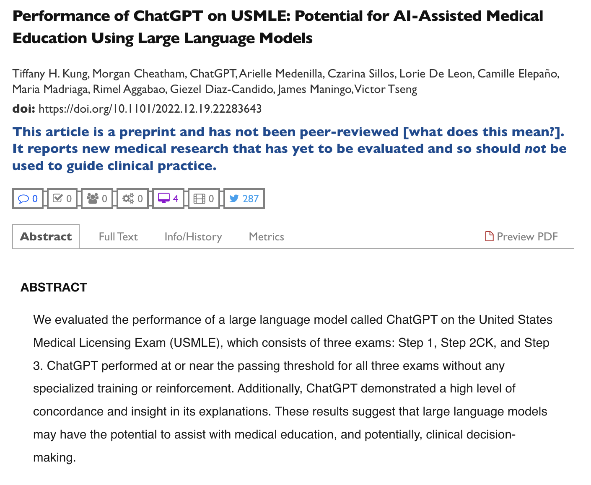
What proportion of CAP is caused by MRSA?
Chat GPT text

Slide 9
What proportion of CAP is caused by MRSA?
~3.7%
https://erj.ersjournals.com/content/34/5/1148

Slide 10
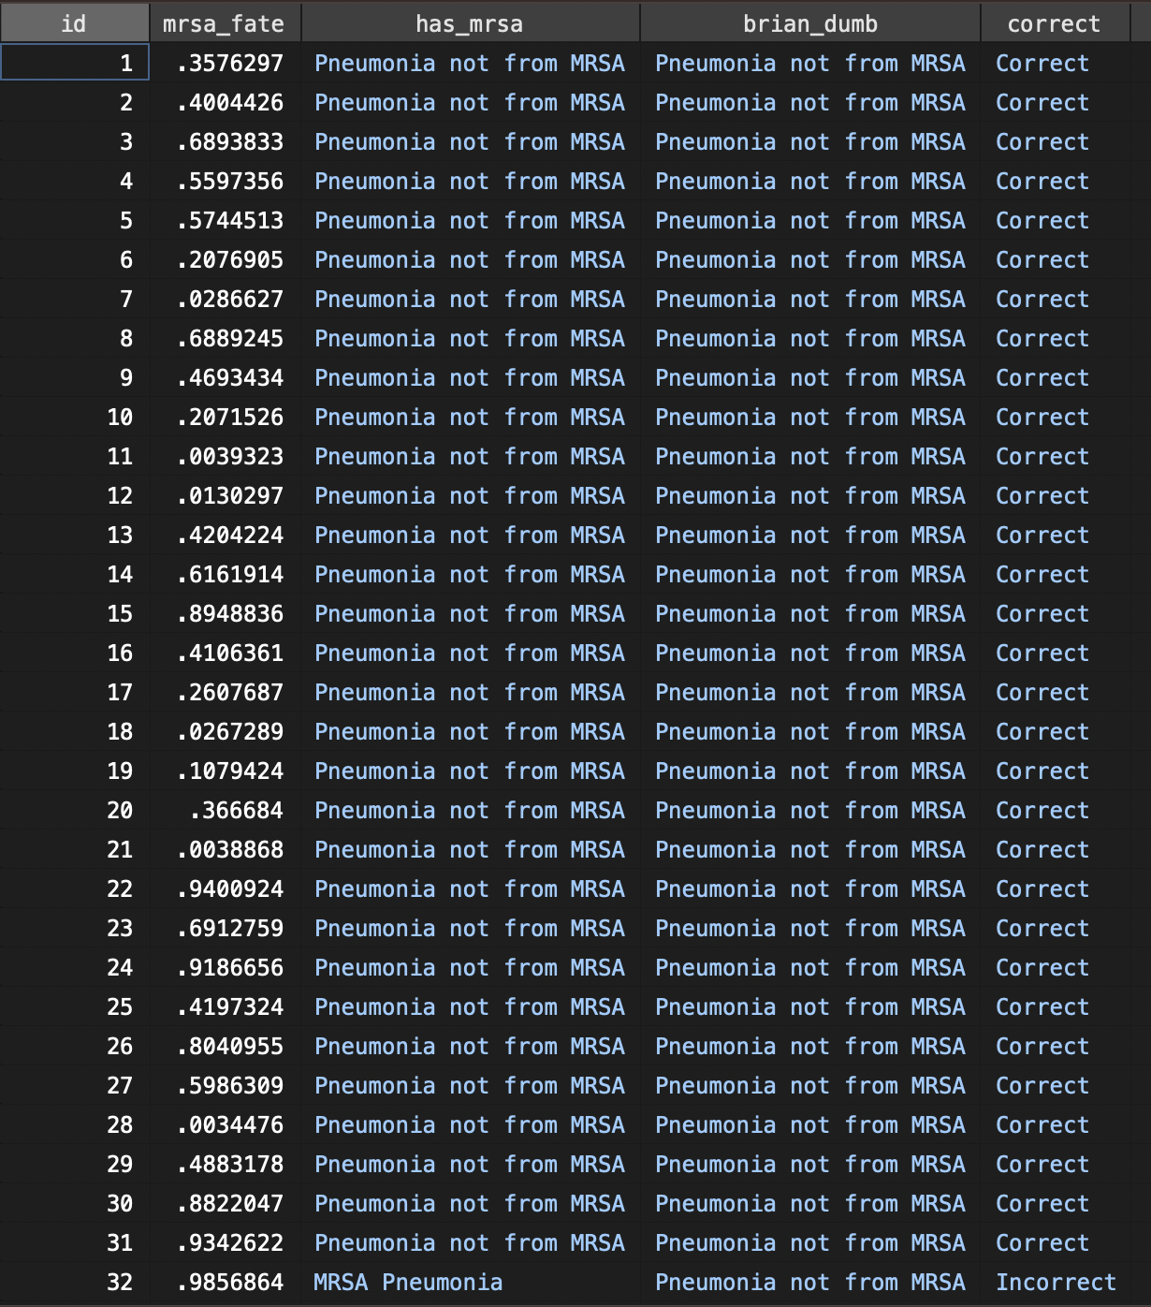
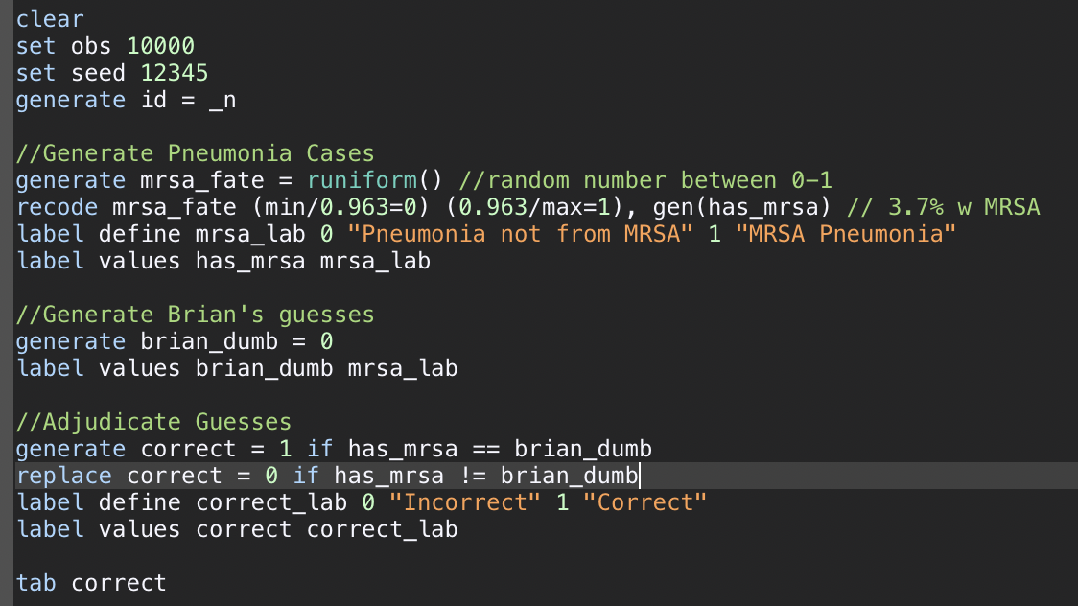
How good am I at predicting who has MRSA pneumonia?

Slide 11
How good am I at predicting who has MRSA pneumonia?

Slide 12
How good am I at predicting who has MRSA pneumonia?

Slide 13
How good am I at predicting who has MRSA pneumonia?

Slide 14
How good am I at predicting who has MRSA pneumonia?

Slide 15
How good am I at predicting who has MRSA pneumonia?

Slide 16
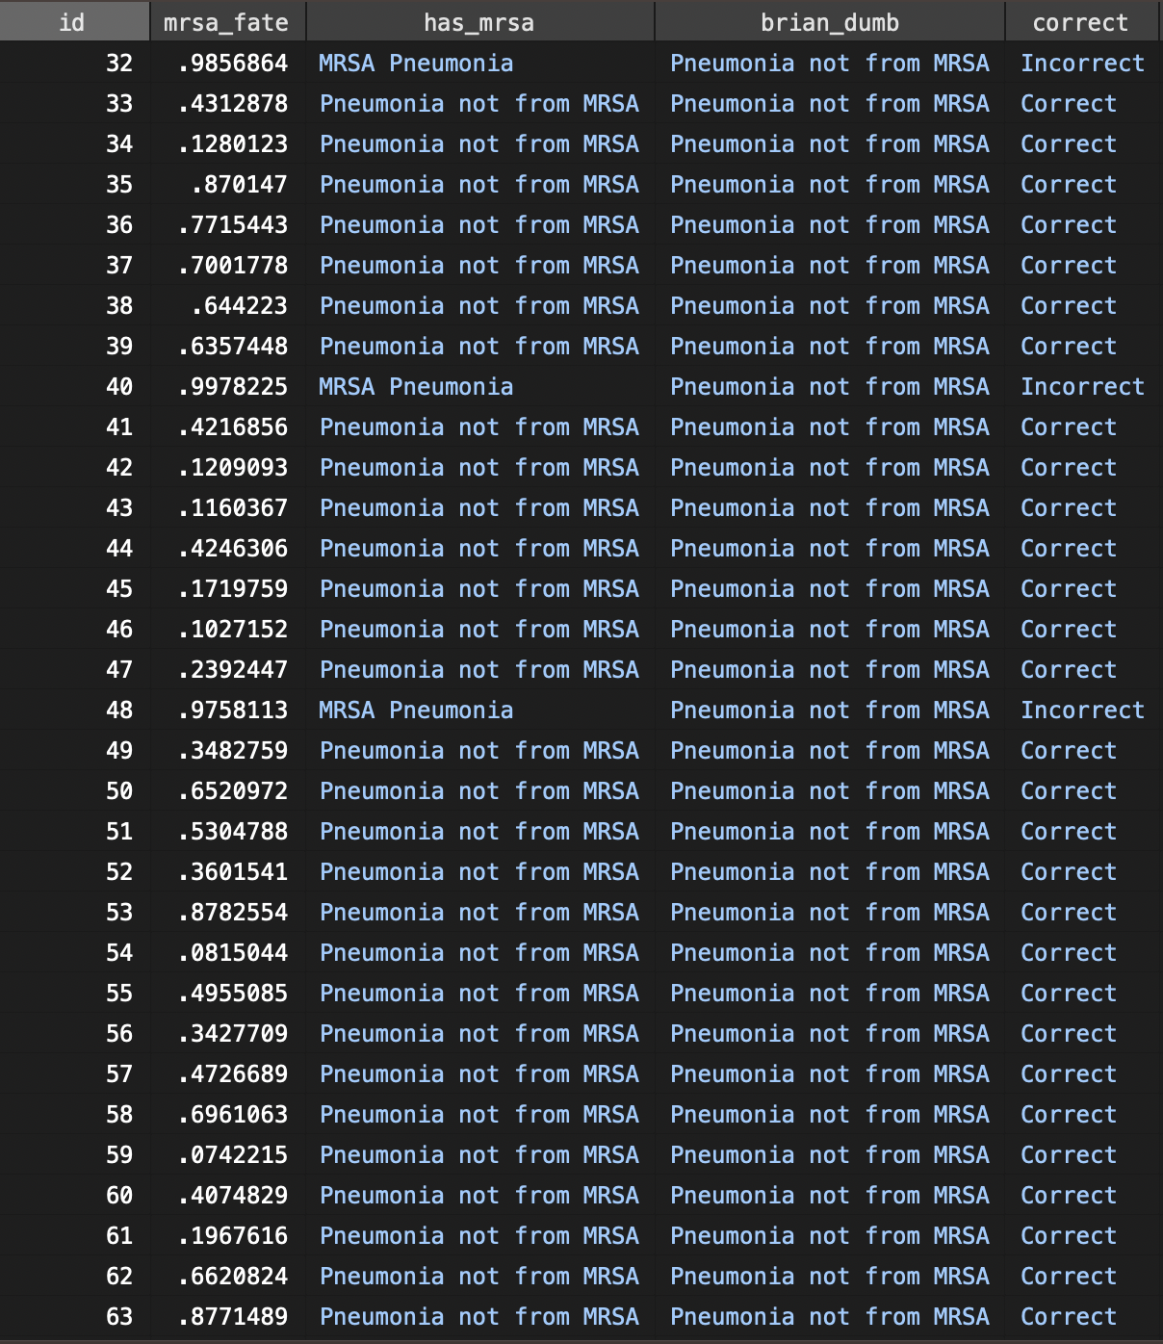
How good am I at predicting who has MRSA pneumonia?
Thinking it was going to be another 32 patients before there was a MRSA pneumonia is called the ”Gambler’s Fallacy”

Slide 17
How good am I at predicting who has MRSA pneumonia?
Dumb Brian is 96.1% accurate!
(What does it feel like to be 96.1% accurate?)

Slide 18

Enter Sensitivity and Specificity:
WW2: RADAR (radio detection and ranging) invented
RADAR Receiver Operators: Is this blip a flock of geese or a bomber?
Like MRSA pneumonia, this is an imbalanced outcome: there are many more blips that are geese than blips that are bombers.
Solution:
In cases where it’s a bomber, what portion do we get correct? (Sensitivity)
In cases where it’s not a bomber, what portion do we get correct? (Specificity)
Notes:
[ ] who applied this to medicine first?

Slide 19
Early medical diagnostics:
https://www.acpjournals.org/doi/abs/10.7326/M20-5028?cookieSet=1

Slide 20
How good am I at predicting who has MRSA pneumonia?
Overall, Dumb Brian is 96.1% accurate!
In cases where it IS MRSA: Dumb Brian is 0% accurate (0% Se)
In cases where it is not MRSA: Dumb Brian is 100% accurate (100% Sp)

Slide 21
SpIN & SnOUT: INCORRECT AND MISLEADING
Specific tests rule diagnoses in; Sensitive tests rule diagnoses out
Dumb Brian is 100% Specific (== Probability of a correct answer when the disease is not present) yet is of no use for ruling diagnoses in or out.

Slide 22
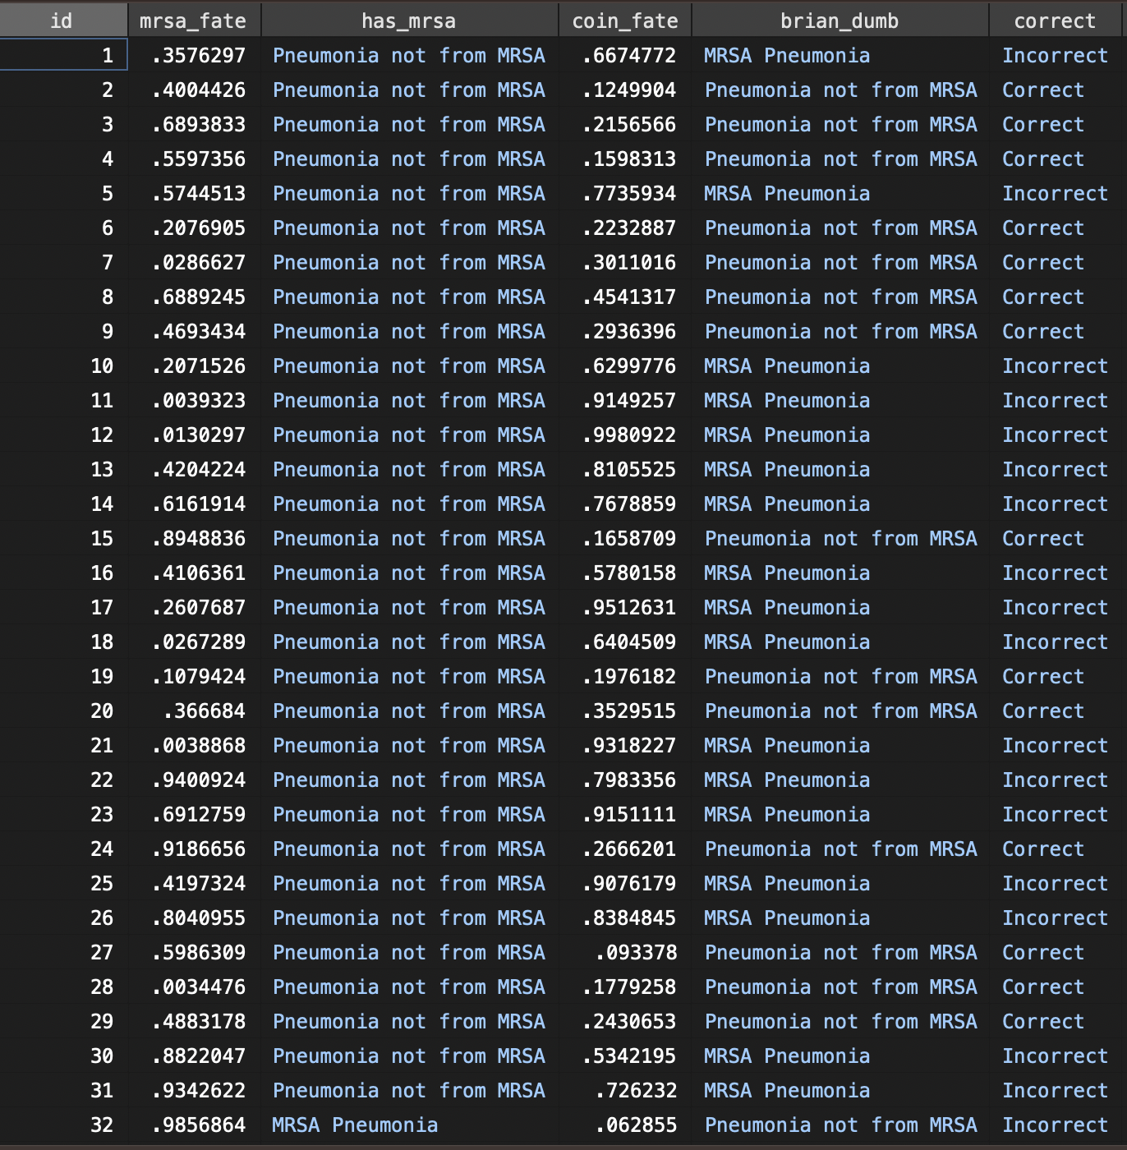
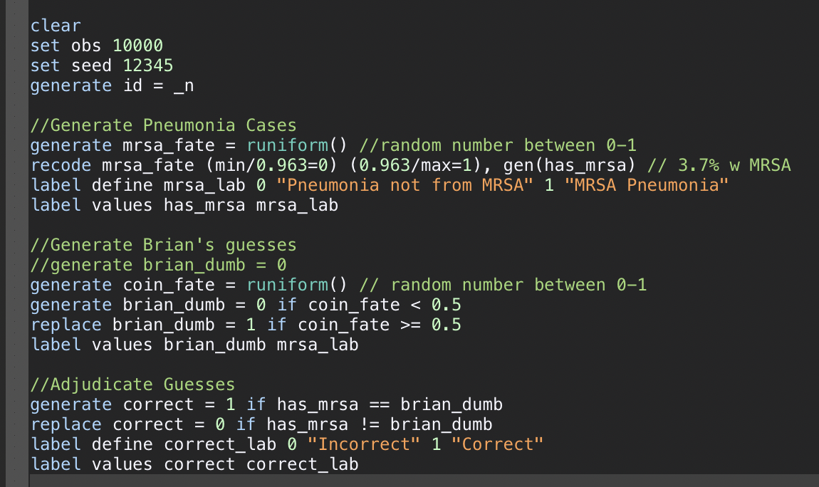
How good am I at predicting who has MRSA pneumonia? Coin Flips
Overall, Coin Flipping Dumb Brian is 49.8% accurate!
In cases where it IS MRSA: Dumb Brian is 54.3% accurate (Se)
In cases where it is not MRSA: Dumb Brian is 49.7% accurate (Sp)

Slide 23
How good am I at predicting who has MRSA pneumonia? Dice 1-4 = Not MRSA, 5-6 = MRSA
Overall, Coin Flipping Dumb Brian is 64.8% accurate!
In cases where it IS MRSA: Dumb Brian is 36% (Se) accurate
In cases where it is not MRSA: Dumb Brian is 65.9% (Sp) accurate

Slide 24
What is the pattern here?
Strategy | Any relation to outcome? | Accuracy | Se | Sp
Always no | No | 96.1% | 0% | 100%
Die: 1-4 = no, 5-6 = yes | No | 64.8% | 36% | 65.9%
(fair) coin flip | No | 49.8% | 54.3% | 49.7%
Rule of 100: A test where sensitivity and specify sum to 100 is worthless (=no change the likelihood that disease is present)

Slide 25
Summary:
Accuracy is a poor measure of performance in when the outcome is uncommon
“Classification of Imbalanced Data”: yes does not ~= no
Even common diagnoses are often far from 50:50
Sensitivity and Specificity are used to solve this problem
but they do not mean what we take them to mean (utility in ruling out or in diagnoses)
Notes:
Accuracy = implicitly gives equal weight to FN and FP

Slide 26
This applies to tests, but also personal performance.
We shouldn’t use “accuracy” in the context of excluding rare diagnoses
It takes much better testing (or sharper reasoning) to make a rarer diagnosis
Thus you ought to be more skeptical of claims of one having been made (Aberegg and Callahan 2021)
It is more impressive to have correctly identified something that is rare.
Brier Score:
Notes:
[ ] Maybe remove this or move to later?
[ ] blue journal delays when sex is less common

Slide 27
Why do Se and Sp != Usefulness for Ruling in and out?
Conditional probability:
the probability of event B occurring IF event A occurs.
P(B | A)
If event A does not occur, the conditional probability has no relevance.
Sensitivity: conditional probability of correct test IF the patient has disease
Specificity: conditional probability of correct test IF the patient does not have disease
Which applies to our patient with pneumonia?

Slide 28
Backwards probability:
A conditional probability that depends on an event that can’t be known (yet) at the time of usage.
A p-value is another example of this: the probability of if null=True, what we be the chance of seeing this result (or more extreme).
Of people who have the disease, how many have the test result? Backward probability
Of people who have a positive test result, how many have the disease? Forward probability (what we want)
Notes:
Because these probabilities are conditional on the outcome, they are more useful for retrospective case-control. In general, it is more natural and useful to study variations in post-test probabilities of disease given diﬀerent test results and diﬀerent patient pre-test characteristics because: (1) in general both the sensitivity and speciﬁcity will vary with the type of patient being diagnosed, (2) sensitivity increases with the severity of the disease present unless the disease is all-or-nothing (3) speciﬁcity can vary with gradations in pre-clinical amount of disease (4) many diagnostic tests are based on continuous rather than binary measurements4.

Slide 29
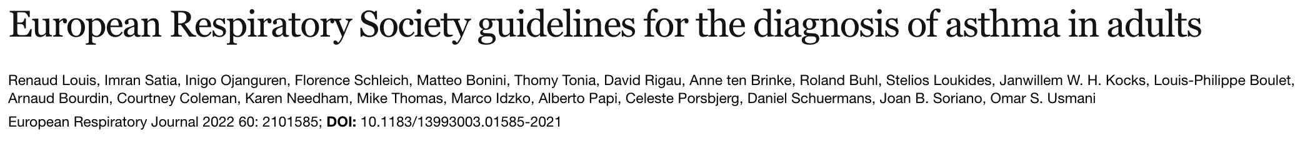
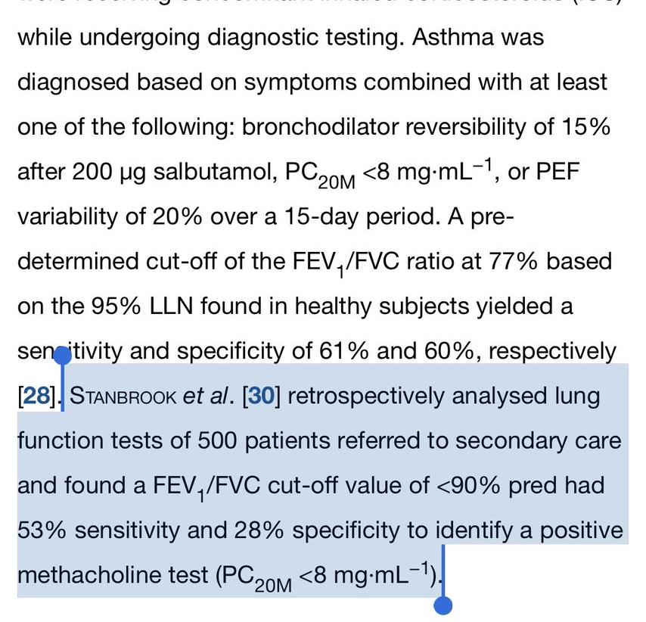
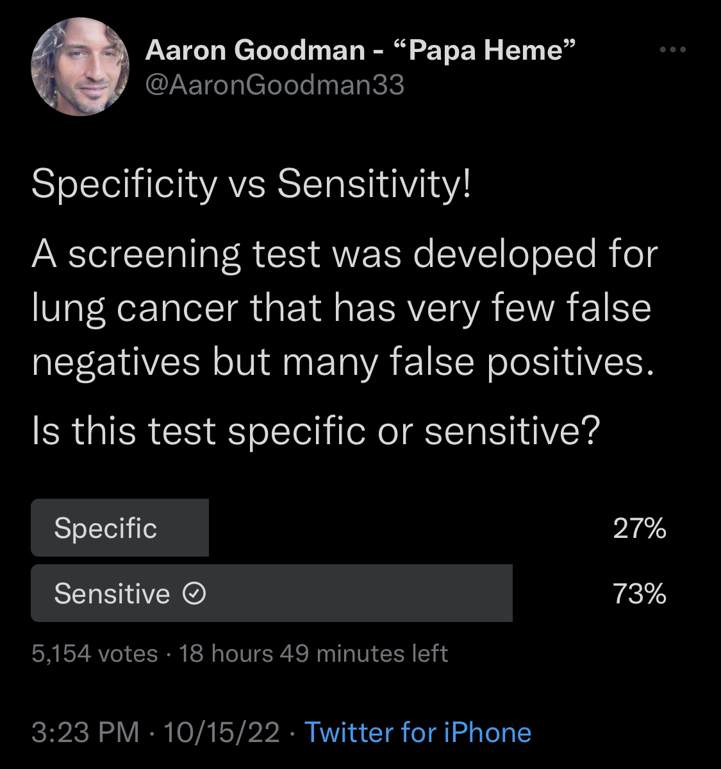
Does it matter?
We (clinicians and researchers) empirically can’t correctly interpret
GERD gigerenzer; majority of MDs in survey’s get this wrong.
Think it’s the chance of
P-value interpretations
“The chance this finding is true given the result P<0.05” != ”The chance you’d get this result if the null hypothesis is true”

Slide 30
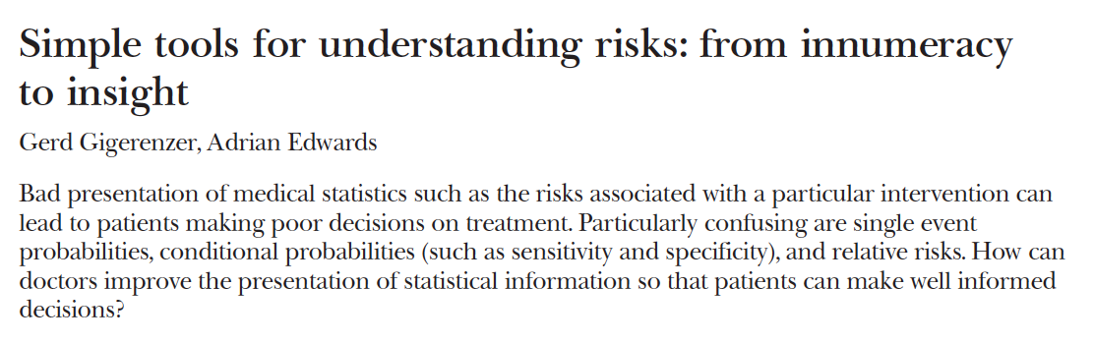
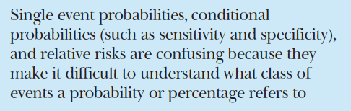
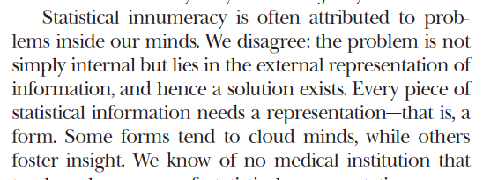
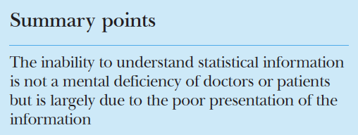
Notes:
[ ] note: I think one point that Gigerenzer makes is that the dominator is implied but not made explicit: ie. the metric is very contingent on what group of people are included as negatives: (ideally, only the people who are under consideration and thus would have the test ordered – thus, test performance is specific to a differential.
→ This could make a good transition to spectrum bias.

Slide 31
So when ARE sensitivity and specificity the right tool?
You are a researcher trying to construct the best MRSA nasal swab possible. You want to tune the threshold for what Cycle Count of DNA counts as possible.
Your aim is to choose the right threshold to balance the number of false positives vs false negatives.
Or, you want to understand the FP and FN rate if a known test is applied to a population
Or, you were a receiver operator interested in weighing FN and FP rates.
Conditioning on unknowable information: ameliorated by repeating over many trials.
Choose a threshold to balance: Receiver Operating Characteristic curve analysis

Slide 32
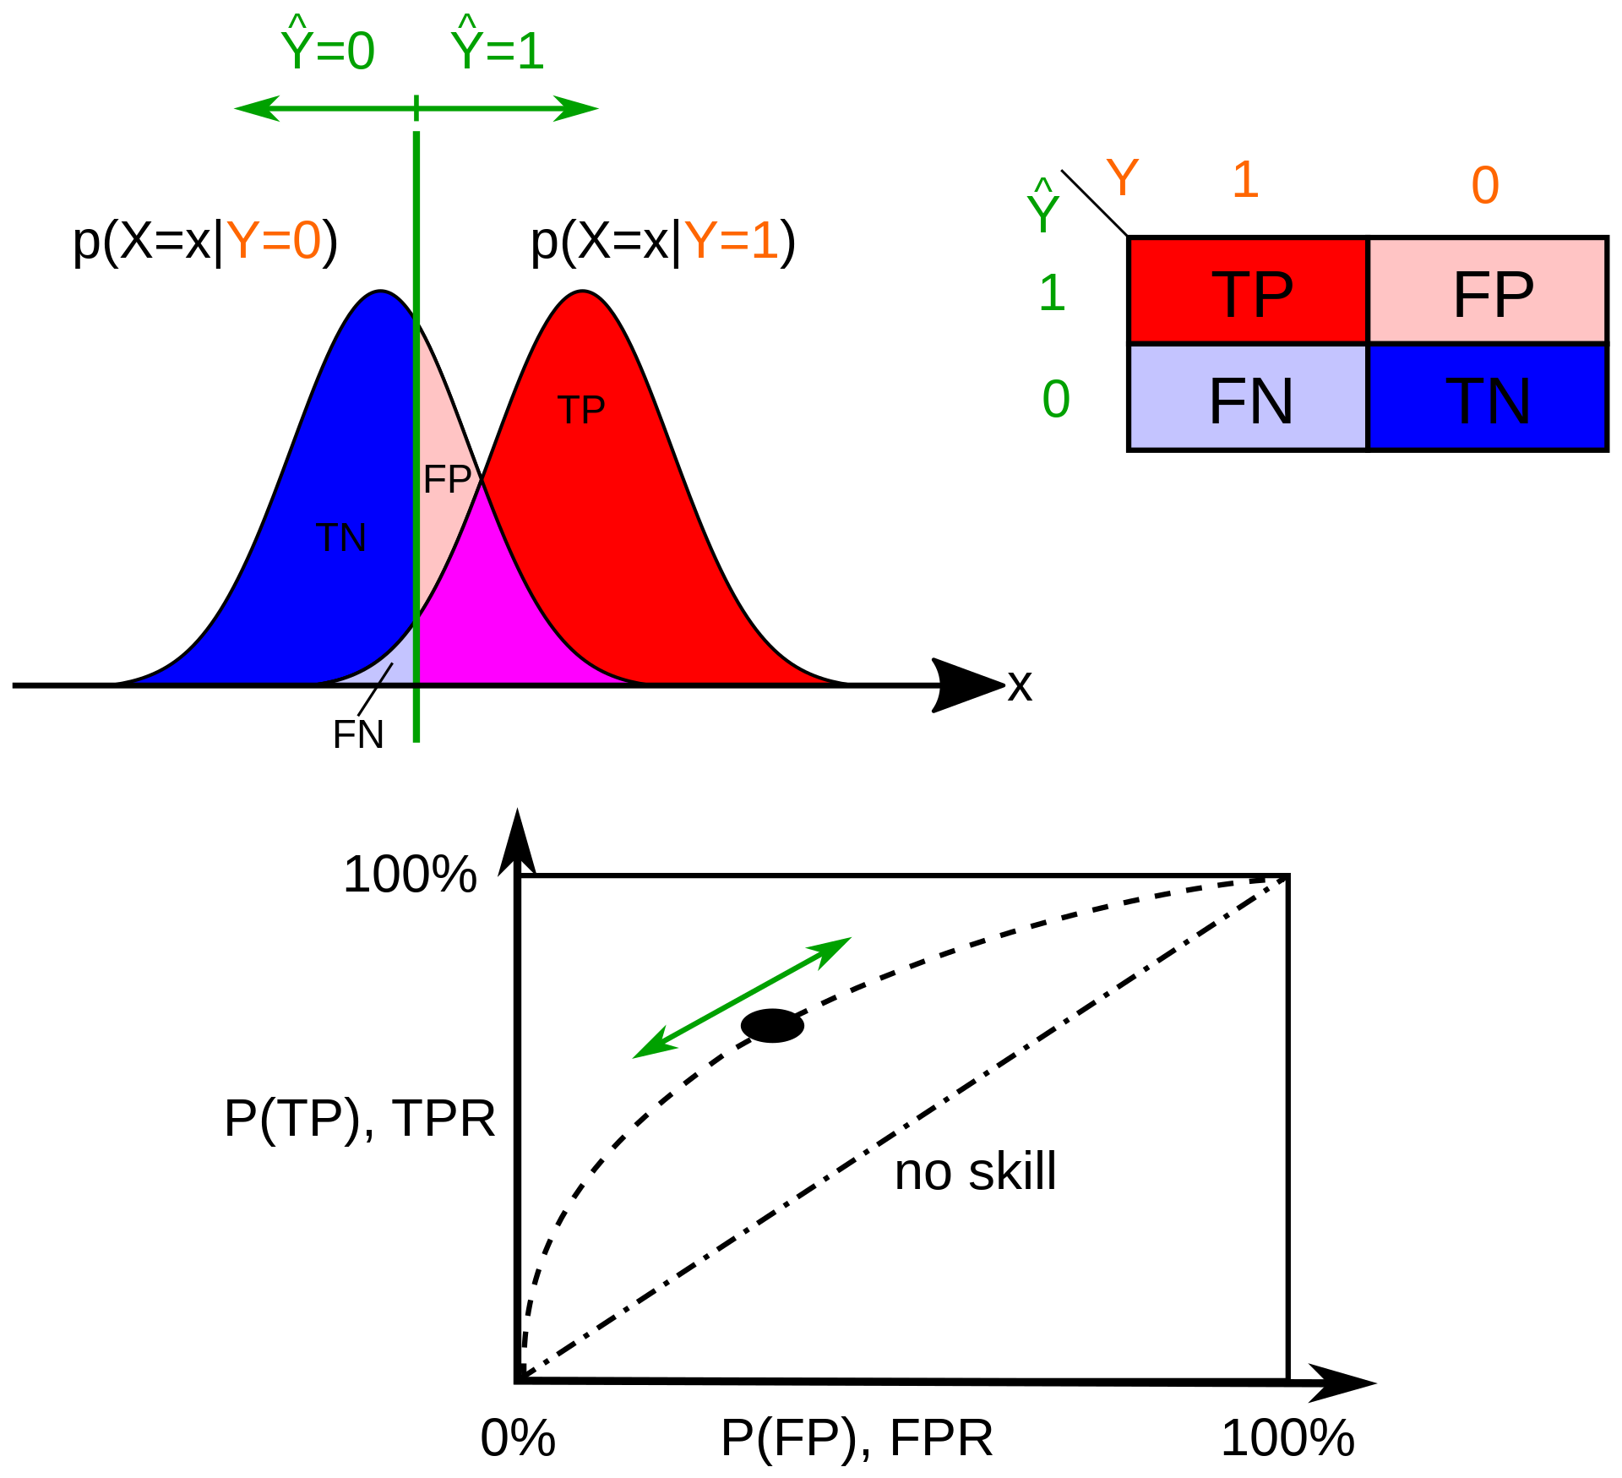
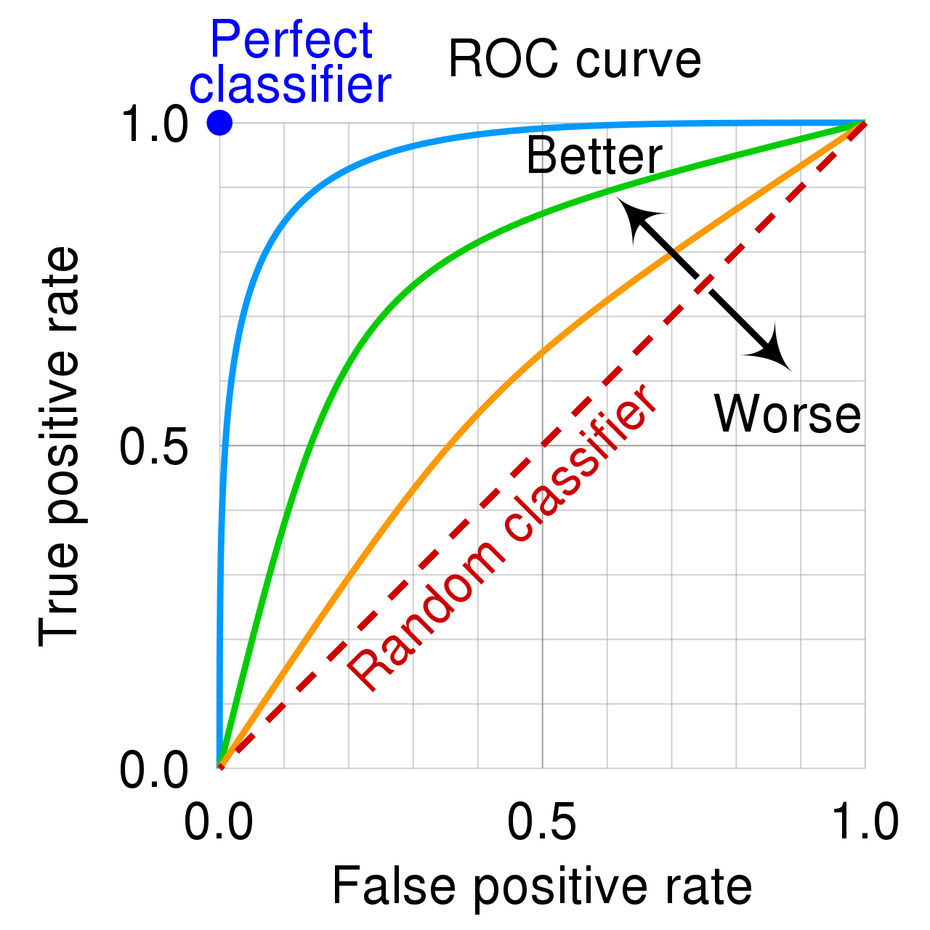
Notes:
wikipedia

Slide 33
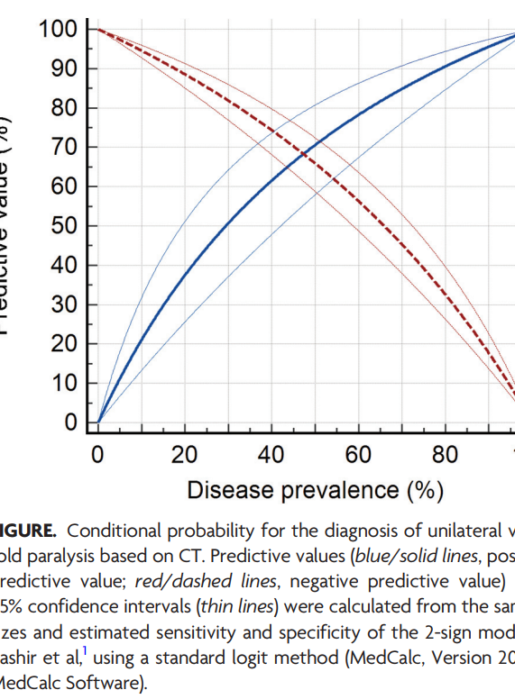
What about +/- predictive value?
Conditional probability of +disease given +test
NOT a backward probability (which is good)
But depends on the prevalence in ‘comparable’ cases. (which is bad)
Often, there is no data on ‘comparable’ cases
A major draw of sensitivity and specificity is that they don’t depend on prevalence*
PPV/NPV are good at a population level, but will mislead in individuals who have risks that differ from the population norm.
Notes:
(given sens 62% and spec 74%).
This tweet has more links related to this https://twitter.com/francisdeng/status/1594120197128220673?s=20&t=FuHCo7wAgF__GbIOPoYLqw
*they actually do in the form of comorbidity distributions.
These are not backwards probabilities. However, they only tell us about population averages.
If the patient’s likelihood of having a disease differs from the population prevalence (which is almost always does) – NPV and PPV will be inaccurate.
Conflating a population for a patient.

Slide 34
What’s the alternative:
Likelihood ratios (same paradigm: of classifying whether patients have a disease or not)
Likelihood ratio is a forward probability , but depends on an estimate of how probable the diagnosis is beforehand, rather than the population prevalence
Or their extension (which can handle continuous variables): Logistic Regression [ ] discussed here https://pubmed.ncbi.nlm.nih.gov/15800301/
Risk modeling (paradigm shift: to predicting the risk of patient outcomes or predicting treatment responsiveness)
e.g. HLD is no longer a diagnosis. ASCVD risk 10y superseded this.
Notes:
http://hbiostat.org/bbr/dx.html

Slide 35
The likelihood principal (not Bayesian statistics)

Slide 36
Computation of LR ratio
Notes:
Good-ness (information added of a test) can be represented on a linear line – log-likelihood ratio (have to think in logs because of the ratio)

Slide 37
Why are LR better? Proper Scoring Rule
“Q: What is a proper accuracy scoring rule?
A: When applied to predicting categorical outcomes, a proper probability accuracy scoring rule is a measure that is optimized when the predicted probabilities are the true outcome probabilities. Examples of proper accuracy scores include the Brier score, the logarithmic probability score, and the log-likelihood from a correct statistical model. Examples of improper scoring rules, i.e., rules that are optimized by a bogus model, are proportion classiﬁed correctly, sensitivity, speciﬁcity, precision, recall, and the c-index (area under the receiver operating characteristic curve).”
Notes:
“There is an existing mathematical theory of how to assign points to probabilistic predictions, namely
the theory of ‘proper scoring rules’. These scoring rules are appealing because they give no incentive
for the forecaster to lie about their probabilistic beliefs.
“
Logarithmic scoring rule= Shannon entropy formulation

Slide 38
If you’re going to dichotomize results and disease states: LR is a much better indicator of the strength of a result.
(you can generate LR’s for various levels of a continuous variable, which is better).

Slide 39
ROC Graphs: Se, Sp vs LR
+Se
+LR
How often positive
+Sp
LR represents how far from the line of coin-flips a test is.
Further from the line is always better.
LR = proper scoring rule
Higher or more leftward is NOT always better
Se Sp = not a proper scoring rule

Slide 40
Test for comprehension
a.) se 85 sp 75 -> +LR 2.83, -LR 0.20
b.) se 90 sp 50 -> +LR 1.8, -LR 0.20
c.) Se 95 sp 25 -> +LR 1.27, -LR 0.20
https://calculator.testingwisely.com/playground

Slide 41
A 55F who is a nurse comes in with sepsis and chest pain, a RUL infiltrate that is cavitating in XR.
Blood cultures are received in the ER. She receives Vanc, Cefepime, and Azithromycin.
Blood and sputum cultures are collected. MRSA nasal swab is obtained and negative. Influenza A is positive.
She says she’s been sick for a week, thought she was doing better then worsened.
Pulmonary is consulted to help 12h after admission. CT is recommended confirms what looks to be a necrotizing pneumonia, no evidence of a lesion. Some ipsilateral LAD. No underlying lung disease.
Do you advise the team to stop vancomycin?

Slide 42
CME:
Question: your intern says that “MRSA nasal swab is a good test at ruling out MRSA pneumonia.” You are feeling extra pedantic today, insisting only on the most truthful statements. Which of the following is true?
MRSA nasal swab is a good test at ruling out disease because it has a high specificity
MRSA nasal swab is a good test at ruling out disease because it has a high sensitivity
MRSA nasal swab is not a good test, but can still be useful.
Ugh. Sensitivity and specificity? These metrics are confusing.
Notes:
it can be useful because MRSA pneumonia is uncommon but not uncommon enough to ignore.

Slide 43
Answer
Question: your intern says that “MRSA nasal swab is a good test at ruling out MRSA pneumonia.” You are feeling extra pedantic today, insisting only on the most truthful statements. Which of the following is true?
MRSA nasal swab is a good test at ruling out disease because it has a high specificity
MRSA nasal swab is a good test at ruling out disease because it has a high sensitivity
MRSA nasal swab is not a good test, but can still be useful: when MRSA pneumonia is unlikely but not so unlikely we can ignore it.
Ugh. Sensitivity and specificity? These metrics are confusing.

Slide 44
SRMA of MRSA nasal swab. Also VA study?
Do they make errors about the distribution of covariates?
https://pubmed.ncbi.nlm.nih.gov/29340593/

Slide 45
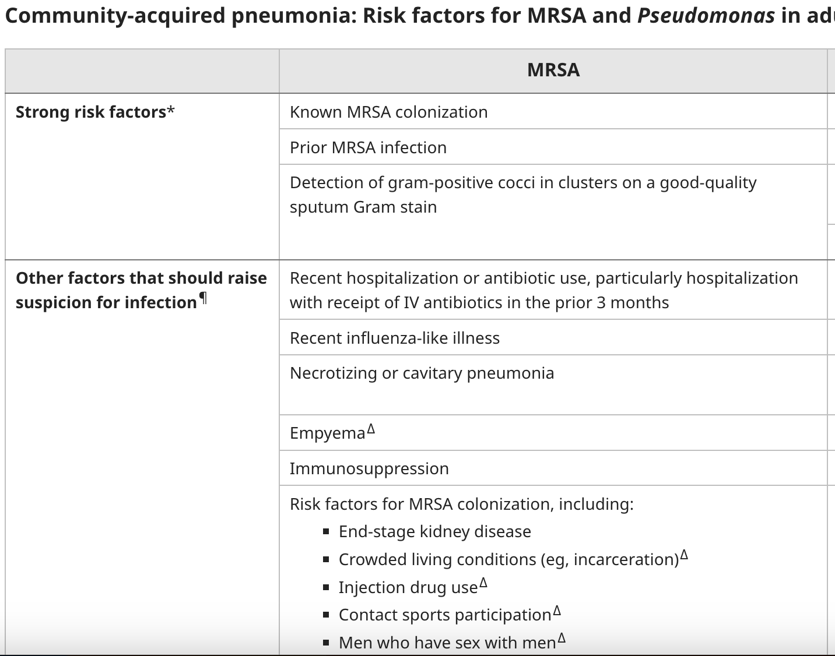
Returning to our case:
Healthcare exposure and cavitary component are both risk factors for MRSA pneumonia
Notes:
Note: you could argue that you could calculate the prevalence of disease among patients who have those risk factors and then use PPV -> this is mathematically equivalent to sequentially applying LRs

Slide 46
Say you take my advice…
If you don’t take off Vanc and it ends up usually being not MRSA.. Will you question whether I was right?

Slide 47
2 common problems with Se and Sp estimates in practice:
Spectrum Bias
Case-control design
Notes:
[ ] how to critique a study marker study would be interesting.

Slide 48
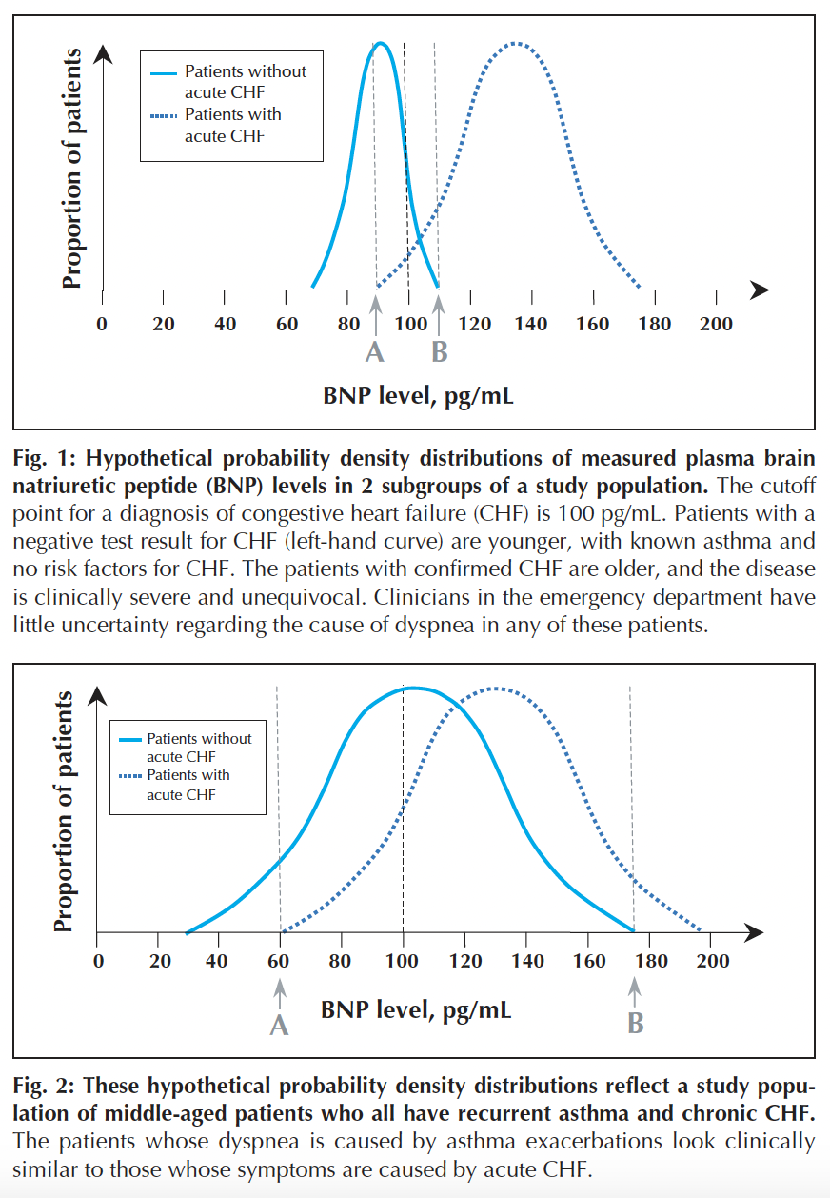
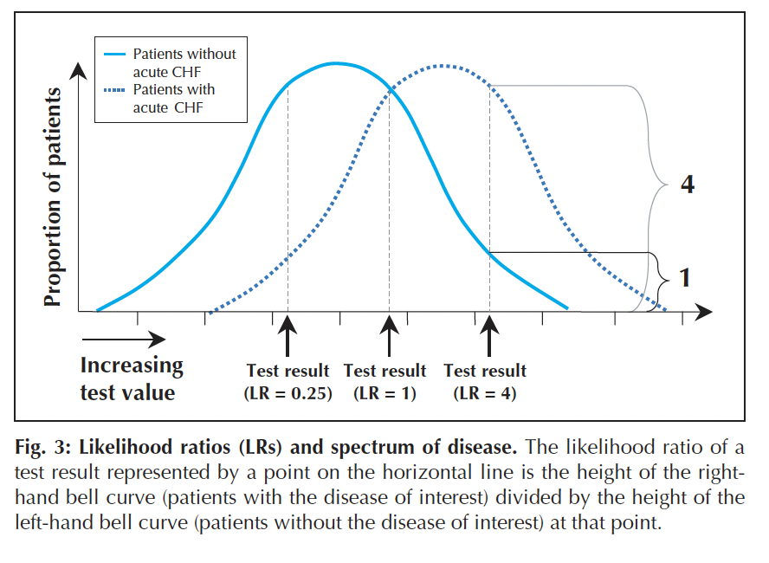
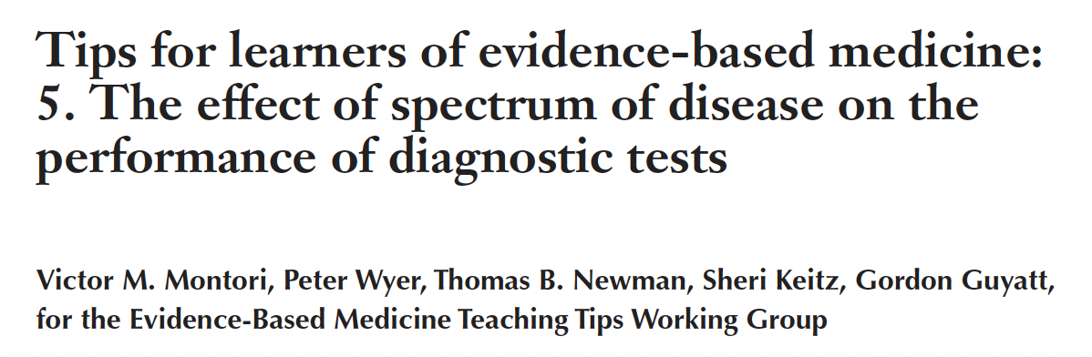

Slide 49
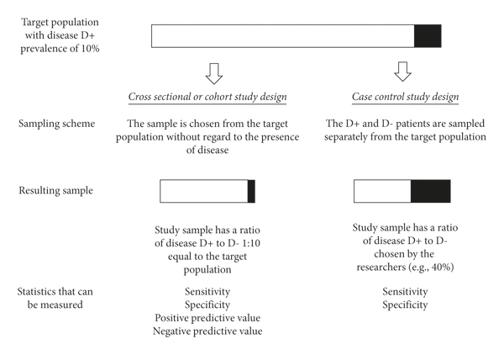
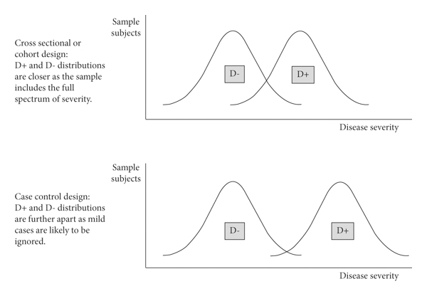
Case control studies for diagnostic tests
Take two groups of patients: healthy controls and patients with (clear cases) of the disease. Then you calculate the 2x2 table of each
Excludes many patients who would be more prone to false positives and false negatives.
People with milder disease (sensitivity increases if there is any comofbidity that increases severity in the population)
Consider: EKG stress test is more sensitive in older patients, men, and those w more vessel dz
People with alternative conditions
When we use tests, we ALWAYS use them where either the patient is ill with the disease in question, or the are ill with another disease. (Healthy isn’t a comparator)
Notes:
From https://www.hindawi.com/journals/rrp/2021/5801662/
Which also has good review of issues relating to diagnostic tests.
[x] https://twitter.com/francisdeng/status/1594120178610352128?s=20&t=e_qUGJY0NQ4omBt-cH0_Vw has good links and visualizations
Are se and sp really independent of prevalence? https://twitter.com/RogueRad/status/940368577290481665

Slide 50
Test your learning:
Can MRSA nasal swab rule out MRSA in sinus infections? Is it a better or worse test for MRSA in sinus and why?

Slide 51
Summary Points
Some tests are very informative while others are not: we need to represent this somehow.
Accuracy is misleading in imbalanced data, which is most of medicine.
Se/Sp fix this and are useful for epidemiologists, but they cause confusion because they are backward probabilities.
PPV & NPV are useful at a population level, but patients that differ from the population average are not well represented.
We can represent the informativeness of diagnostic tests in a way that matches what we intend to communicate
Use likelihood ratios to represent test characteristics in clinical care.
Notes:
Epidemiologists, and those developing tests, should continue to use Se and Sp.

Slide 52
Other slides

Slide 53

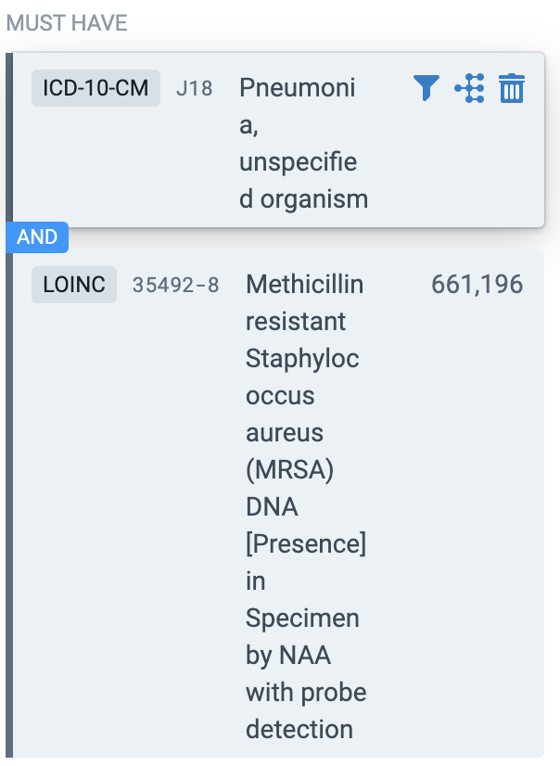
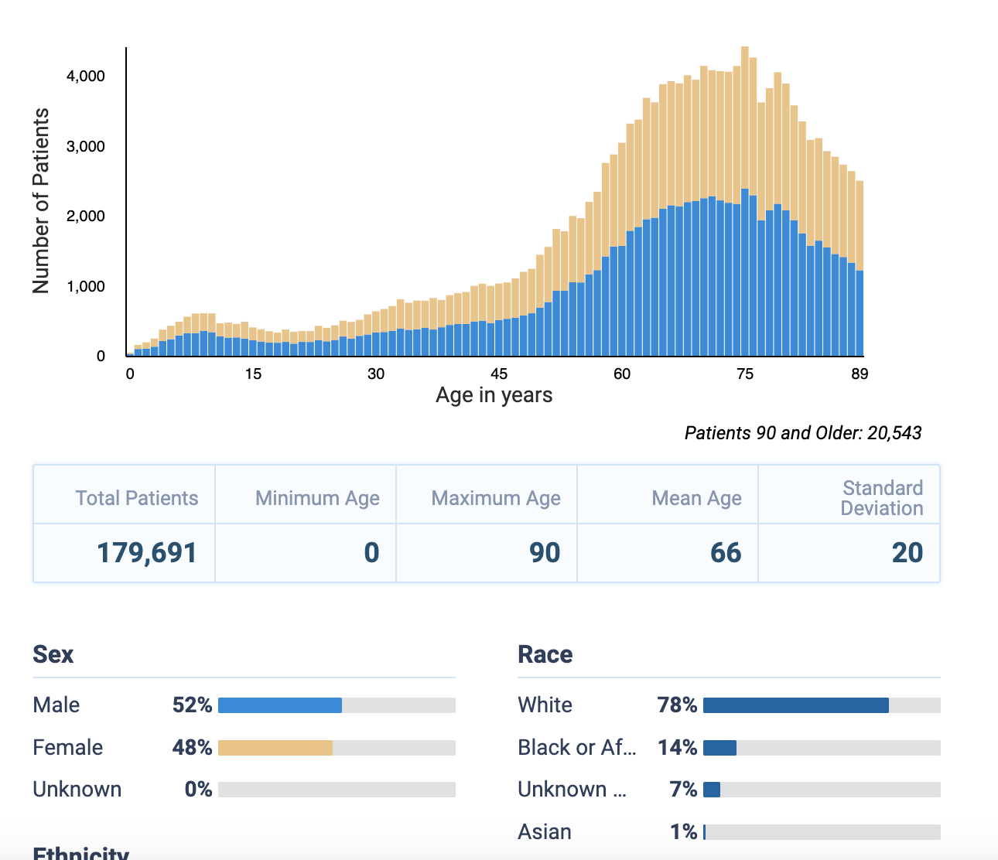
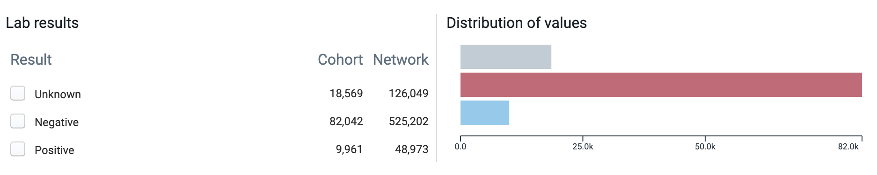
What proportion of patients with CAP who have MRSA nasal swabs ordered have a positive result?

Slide 54
Roadmap: Problems with Se and Sp
They are conditional probabilities that are conditional on something you don’t know
*They make continuous variables into dichotomous ones, and thus discard information
They do not describe the ability of a test to rule out (sensitivity) and rule in (specificity), like people think they do
*They are often derived from case-control studies, which over-estimate the usefulness of tests
Therefore, they are unnatural and confusing ways to describe the usefulness of tests. It is only a historical coincidence we use them.

Slide 55
MRSA review

Slide 56
Good discussion; review for framing
https://stats.stackexchange.com/questions/312780/why-is-accuracy-not-the-best-measure-for-assessing-classification-models

Slide 57
Abductive reasoning: [ ] take this from other paper

Slide 58
https://www.bmj.com/content/358/bmj.j4071?ijkey=7569ba3edc8f57718804938da71b1cadd2390a6d&keytype2=tf_ipsecsha
This one argues that test chars can only really be understood in the context of a differential.

Slide 59
Se and Sp are NOT proper scoring rules
Se:sp
[ ] What does a likelihood ratio represent on the ROC graph? Perpendicular to the 50/50 line vs vertical and horizontal
→ finding the optimal cutoff requires weighing the harm of a FP vs a FN – for this, Se and Sp are useful. However, we are not doing this – we are interested in the amount of information added. … maximizing LR and an analysis of fp and fn might give different results?

Slide 60
Diagnosticity argument:
Do not use sensitivity, specificity, NPV, PPV to talk about the “goodness” or usefulness of a test in individual patient care: it is misleading and the only reason we do it is an idiosyncrasy of how things were initially conceptualized.

Slide 61
Argument:
Imagine that a patient has a 10% chance of having a disease.
(Either, if you saw a patient with the same relevant characteristics 10x, on average - 1 would have the disease = Frequentist perspective. Or, given what I know there is a 10% chance that this patient is, in fact, diseased = bayesian.)

Slide 62
Out of the following tests: (varying se and sp), which would you like best?
All same
Thus, se (or sp) does not tell us what we want to know.
Additionally, while NPV, and PPV discriminate OK (meaning, a better PPV or a better NPV is indexed better, they are miscalibrated - your estimate will be wrong if your patient has any characteristics that make their risk different from the population average).

Slide 63
Thus use likelihood ratios.
Then go in to Harrell’s arguments.
https://hbiostat.org/blog/post/addvalue/

Slide 64
—> dive in to specificity/sensitivity; idea of diagnostic tests as very simple models -> critique of the analysis approach from that lens.
(Dichotomizing = further simplification and loss of information)
(Considering a result in isolation - without collinear information - is not)

Slide 65
Why can’t we just say how accurate a test is?
Accuracy does not tell us in what way we are wrong.
Accuracy = (TP + TN) / (TP+FP+TN+FN) = ’how often does the test get it right’
If Positives are much less common than negatives, always saying “no disease” will be highly accurate. (called ‘class imabalance’
Why did we end up with Sensitivity and Specificity in the first place?
—> Accuracy of a test shortcomings.
Class imbalance…. Epi text book

Slide 66
?Reference class problem - study patients “like the patient” - but there are In infinite number of ways you could do this.
Ability of a test to add information to other tests
(Brief detour into added values metrics like net reclassification index)
Assessment of a diagnostic test involves consideration of 3 components of effectiveness: accuracy, clinical utility, and patient benefit:
To be effective, a test must be accurate, which is determined by sensitivity (the true-positive rate) and specificity (the true-negative rate) [REFORMULATED AS LIKELIHOOD RATIOS].
A diagnostic test with clinical utility is one that has a measurable net positive effect on a patient’s clinical outcome.
—> can avoid unnecessary exposure.
A diagnostic test with patient benefit is one that positively affects a patient’s health or well-being in some way, even if the test result does not directly influence clinical treatment decisions or prognosis.
—> comparison to MRSA-based de-escelation? Probably depends a lot on what

Slide 67
Why did we even develop this convention in the first place?
Why did we even adopt this convention?
https://mlu-explain.github.io/roc-auc/
‘ROC curves were first employed during World War 2 to analyze radar signals: After missing the Japanese aircraft that carried out the attack on Pearl Harbor, the US wanted their radar receiver operators to better identify aircraft from signal noise (e.g. clouds). The operator's ability to identify as many true positives as possible while minimizing false positives was named the Receiver Operating Characteristic, and the curve analyzing their predictive abilities was called the ROC Curve. Today, ROC curves are used in a number of contexts, including clinical settings (to assess the diagnostic accuracy of a test) and machine learning (the focus of this article).’
The AUC is the probability that the model will rank a randomly chosen positive example more highly than a randomly chosen negative example
if the model always predicts a positive sample is more likely to have a positive label than a negative sample, then it will have an AUC of 1. This strategy also provides a very easy method to estimate the AUC: simply tally up the proportion of correctly ranked positive-negative pairs!
In cases when you desire well-calibrated probability outputs (i.e. when you care about the true likelihood of an event, and not just model performance), ROC/AUC will give us no such information. Additionally, the AUC metric treats all classification errors equally, ignoring the potential consequences of ignoring one type over another.
http://bedside-rounds.org/episode-63-signals/
——-

Slide 68
“A test result is merely a number that is open to interpretation. The idea that a test is either true or false took seed in “signal-detection-theory” in the 1940’s in radar and psychometrics. A signal on a radar screen may be an enemy, or a flock of birds, and training in radar detection aimed to increase the true detections of enemy while reducing a retaliatory barrage at our feathered friends (falsely detected as enemy). In diagnostic testing, values for the test result above the cut-off value are positive (enemy), and, below, negative (birds). However, as in radar detection, some signals are stronger than others and the ability to determine true from false depends on the strength of the signal. ”

Slide 69
Bayesian vs Likelihoodist vs Frequentists statistical formulations - https://plato.stanford.edu/entries/probability-interpret/

Slide 70
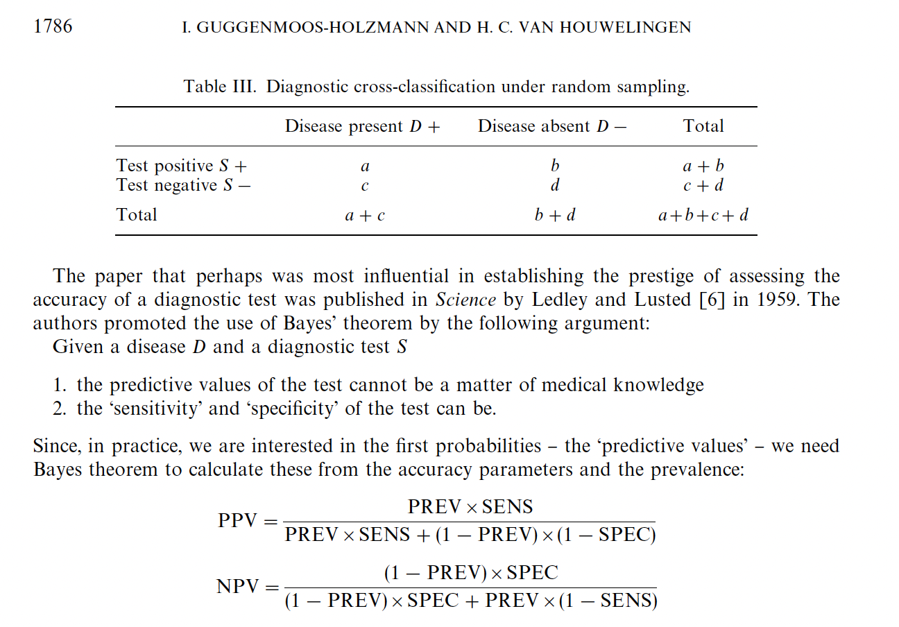
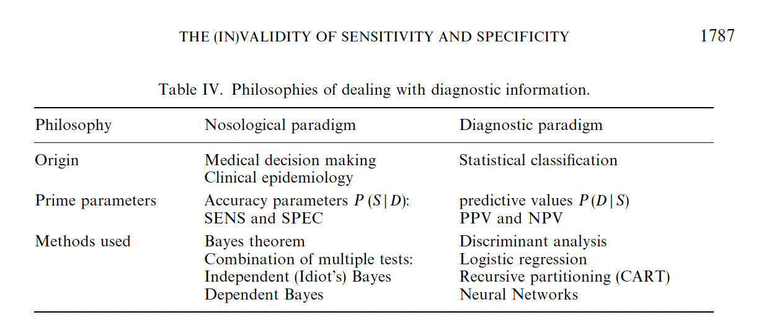
Statist. Med. 2000; 19:1783}1792 The (In)Validity of sensitivity and speci"city

Slide 71
[ ] Could you calculate differential likelihood conditional on age, weight, gender?
‘Type 1. The first is the ‘overall’ likelihood ratio, which is the frequency of a finding in those with a diagnosis divided by the frequency of the same finding in those without the diagnosis (also called the ‘sensitivity’ of a test divided by its ‘false positive rate’ (i.e. 1 minus the specificity).
Type 2. The second type is the ‘differential’ likelihood ratio, which is the frequency of the finding in those with a diagnosis divided by the frequency of the same finding in a rival differential diagnostic possibility. This involves one ‘sensitivity’ being divided by another ‘sensitivity’.
It is the second type—the differential likelihood ratio that allows a finding to be assessed for use in diagnosis by probable elimination. This ratio needs to be as high as possible; if it is infinity, then it shows that the rival diagnosis is impossible. When a likelihood ratio is used in calculations, it is the rival diagnosis’s sensitivity that is put on top, so that the likelihood ratio of infinity becomes a likelihood ratio of zero.
“
https://academic.oup.com/book/31795/chapter/266181309?login=false

Slide 72
Take-aways
For decisions about testing on individual patients, Sensitivity and Specificity are the wrong test characteristics to use because they are confusing to apply (reference class problem, forward probabilities) and are not proper scoring rules for how their common use case (not proper scoring rules)
Positive and negative predictive value are also inappropriate as they imply all patients are equally likely to have the disease.
Likelihood ratios address all the above issues: they are easier to understand and they mean what we think they mean.
They are not perfect (dichotomization)

Slide 73
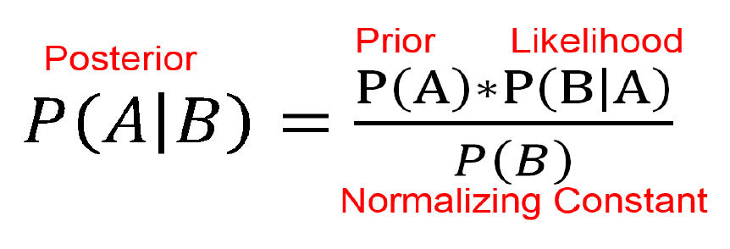
Review approach in: Tell me the odds,
https://a.co/6ksOrXe
https://www.amazon.com/gp/product/B01AZXQY1K
http://www.fairlynerdy.com/an-intuitive-guide-to-bayes-theorem/

Slide 74
Se, Sp are not the right operator characteristics for clinical use
Confusion Matrix | Test (+) | Test (-)
Ref. Std (+) | True Positive (TP) | False Negative (FN) | Se: TP / (TP+FN) In those w/ dz, what portion does the test get right? | In practice, we do not know which row we are in
Ref. Std (-) | False Positive (FP) | True Negative (TN) | Sp: TN / (TN + FP) In those w/o dz, what portion does the test get right?
 | PPV : TP / (TP+FP) In those w/ (+) test, what portion does the test get right? | NPV: TN / (TN+FN) In those w/ (-) test, what portion does the test get right?
 | In practice, know which column we are in

Slide 75
Relationship to ’Information Added’
Conditional probability:
Pr( [Test +] given [has dz]) = Pr( [Test +] and [has dz])/Pr([has dz])
Bayes Theorem:
Pr ( [has dz] given [Test +]) = Pr ([has dz]) * Pr ([Test+] given [has dz]) / Pr([Test+])
We want: Conditional probability the patient has the disease given a positive test / Conditional probability the patient doesn’t have the disease given a positive test
Plug in to bayes and solve: Pr([test+]) drops, leaves you with a likelihood ratio and the Pr([has dz]) aka your pretest probability.
+ Likelihood ratio = Pr([Test + and Have Dz]) / Pr ([Have Dz]) over Pr([Test – and have dz]) / Pr([don’t have dz])
+LR = se / (1-sp)

Slide 76
Sp 80%, Se 20% - good confirmatory test?
Rule of 100: If se+sp = 100, then LR = 1. No information is added.
Spectrum of utility
Do one of these with the pie charts?

